Slide 1

Tech & Check Cooperative Presentation
Innovative Database and Information Systems (IDIR) Lab
CSE Department, UT-Arlington
February 13, 2019
idir.uta.edu

Slide 2
Outline
ClaimBuster
New API
Latest claim spotting models
Claim-related Frames
Newly defined frames
Frame detection and frame element extraction
Frame Annotation Tool
ClaimPortal
Claim Matching

Slide 3

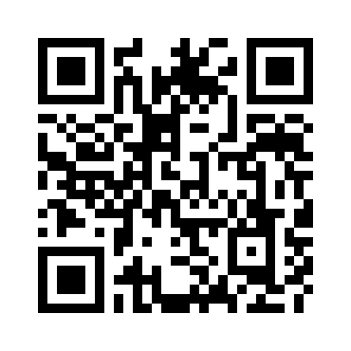
Toward the Holy Grail of Automated Fact-checking
idir.uta.edu/claimbuster

Slide 4

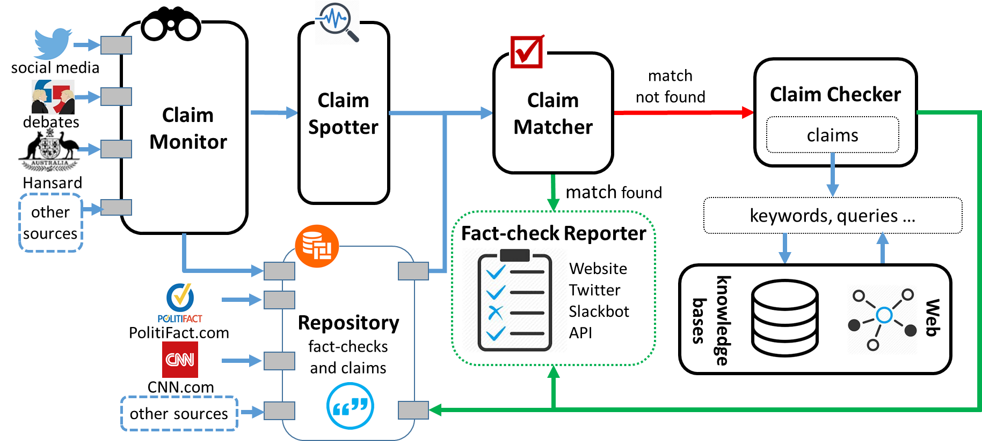
The First-ever End-to-end Fact-checking System
4

Slide 5
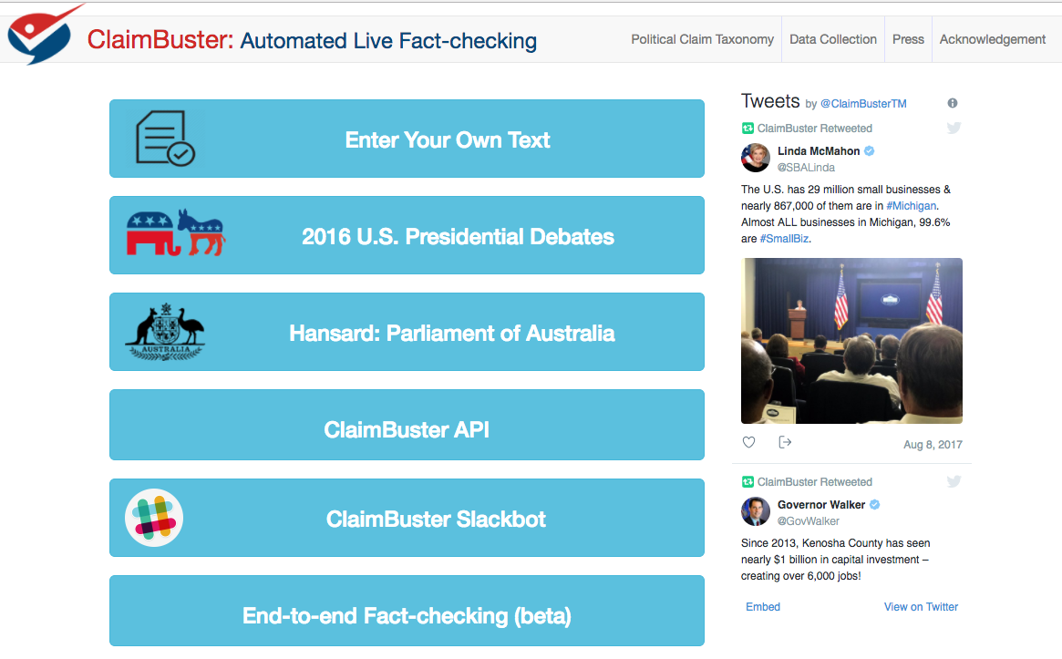
5

Slide 6
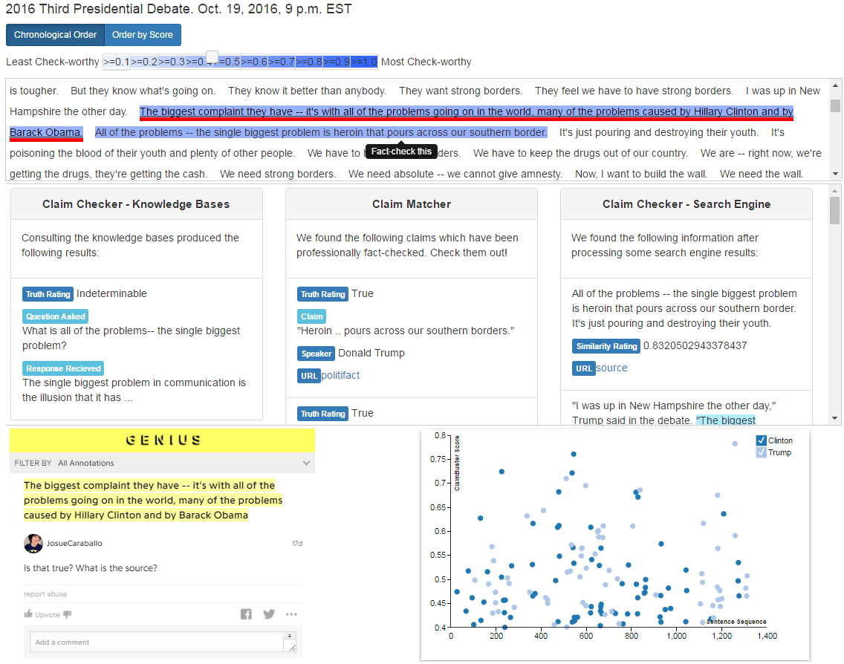
6

Slide 7
New ClaimBuster API
Changes
New server to host the API which should be able to handle heavier workloads
API will require a key to use, which can be obtained after registration. It will allow us to monitor and scale the API accordingly with respect to usage.
Endpoints might change slightly to allow for better versioning of future updates to the API.

Slide 8
LSTM-based Model for Claim Spotting
Model based on an LSTM (long short-term memory) network
Tested several different word embeddings but found no significant difference in overall performance
Different embeddings did have different affinities (i.e., some produce models which score text with numbers higher on average).
We used nonsensical sentences to make the model more resistant to attacks. The neural models outperformed the SVM model by 29% in precision and 12% in recall.

Slide 9
Adversarially Trained LSTM
Training the LSTM model on adversarial (modified) examples.
Adversarial noise (perturbations), designed to maximize the chance of misclassification by the network, was calculated using back-propagation.
Perturbation was applied to word-embeddings rather than directly to the input.
Precision, Recall and F1-Score were improved across all output classes.

Slide 10
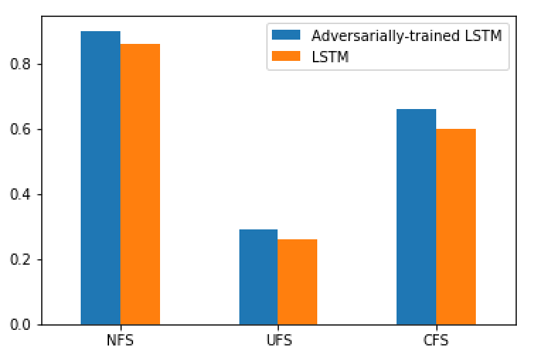
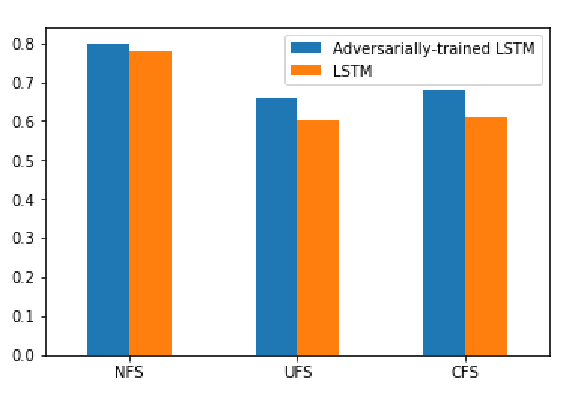
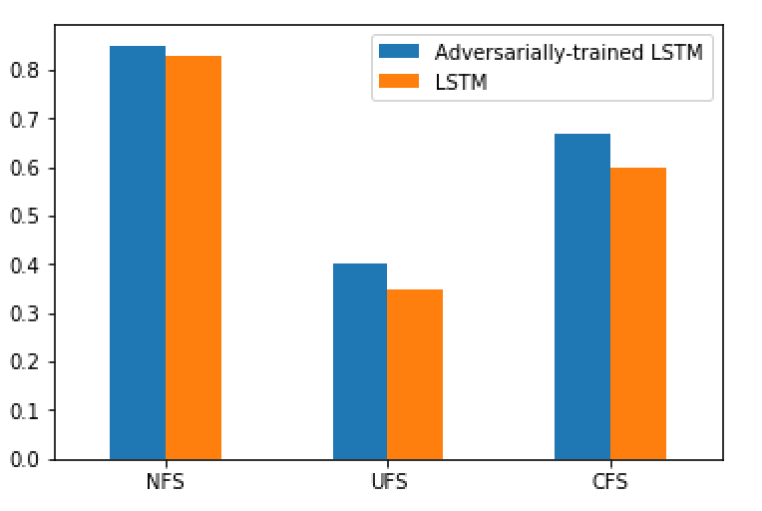
Adversarially Trained LSTM
Recall
Precision
F1-score

Slide 11
Claim-related Frames

Slide 12
Modeling Factual Claims
An extension of FrameNet (Baker et. al., 1998) for structured and semantic modeling of factual claims.
Capture various aspects of a factual claim: domain and topic, entities involved and their relationships, quantities, comparisons, aggregate structures ...
Useful for various steps in automating fact-checking: detecting factual claims, matching claims with fact-checks, translating claims to structured queries, ...

Slide 13
Defining New Frames
Collected fact-checked claims from PolitiFact
Examined a subset of these claims one by one
Grouped claims similar in nature
Created new frames for a claim group if it doesn’t exist in FrameNet
20 frames (13 newly created)
900 labelled factual claims

Slide 14
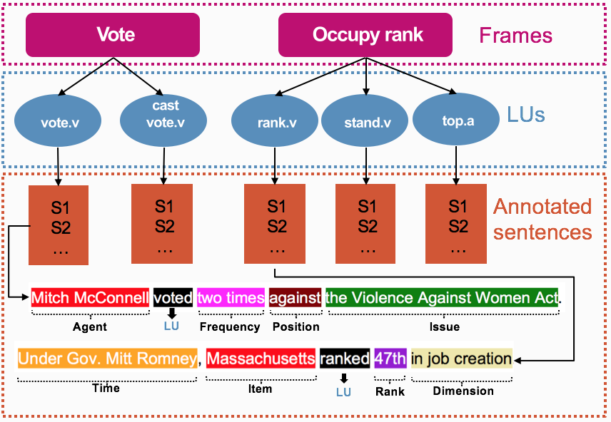
Figure: Vote and Occupy rank frames along with their LUs.
Notes:
An exemplified sentence for vote and rank Lus with color-coded frame annotations below. Labels below each sentence are frame specific frame
elements (FEs).

Slide 15
Preliminary Experiments: Claim Detection
Task:
Claim spotting (identifying factual claims) as frame identification task
Used open-sesame for learning frame identification models
Training data: 7 existing frames (from FrameNet itself, already labelled), 3 new frames (from PolitiFact, labelled by ourselves)
Test data: 7 existing frames + 3 new frames (from Share the Facts, labelled by ourselves)

Slide 16
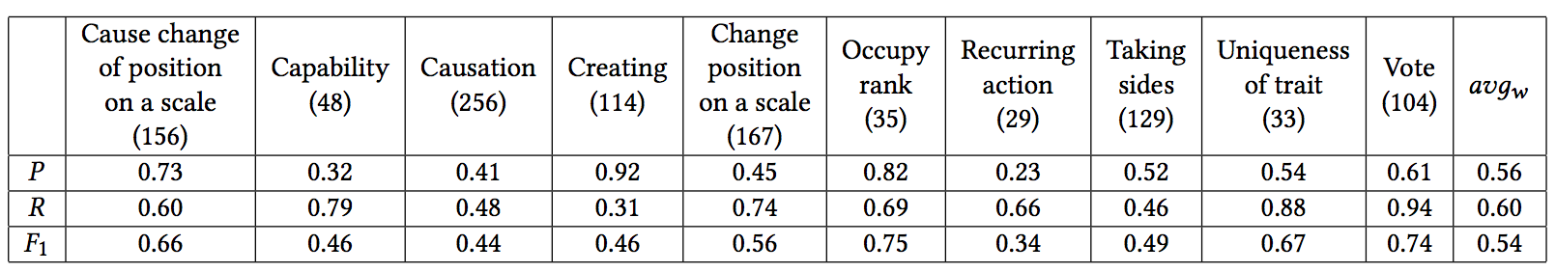
Preliminary Experiments: Claim Spotting
New frames Uniqueness of trait and Vote performed on par with existing frames
Model’s performance could be improved with more training data
Developed a frame annotator tool to annotate more sentences
Notes:
“Recurring action”, “Uniqueness of trait”, and “Vote“ are newly created frames

Slide 17
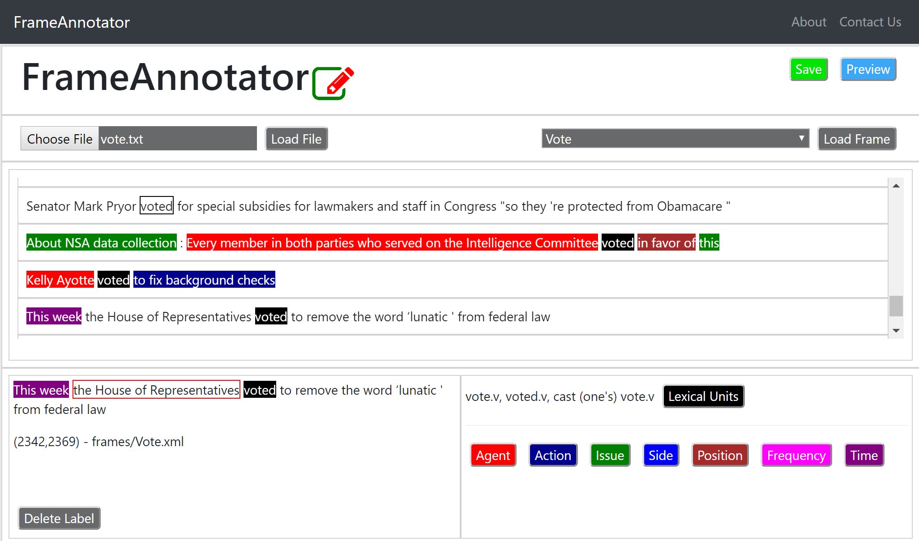
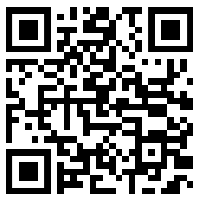
https://idir-server3.uta.edu/frameannotator/

Slide 18
ClaimPortal
Integrated Monitoring, Searching, Checking, and Analytics of Factual Claims on Twitter

Slide 19
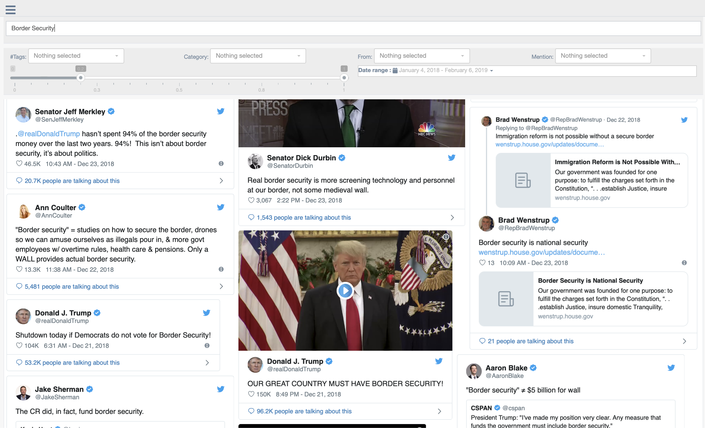
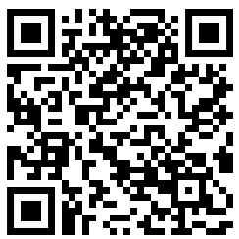
https://idir-server3.uta.edu/claimportal/frontendv2/production/

Slide 20
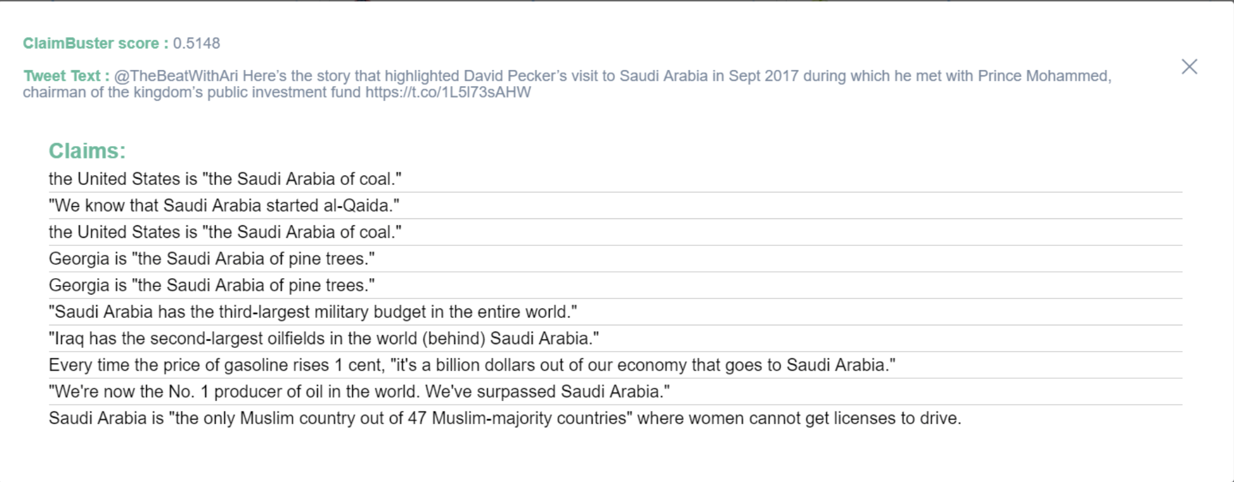

Slide 21

Claim Matching
Does
Textual Entailment help Claim Matching?

Slide 22
ClaimPairs Dataset
ID | Premise Claim (P) | Hypothesis Claim (H) | Entail. | Contra. | Match.
1 | Hostages were released as soon as Ronald Reagan took office because Iran perceived that America was ”no longer under the command of someone weak.” | It’s worth remembering Iran released our hostages the day Ronald Reagan was sworn into office. | 1 | 0 | 1
2 | While our people work longer hours for lower wages, almost all new income goes to the top 1 percent. | I’m running for president because our economy is rigged because working people are working longer hours for lower wages and almost all of new wealth and income being created is going to the top one percent. | 0 | 0 | 0
3 | When President Obama took office, we were losing 700,000 jobs a month. Now we’ve had job growth, I think, for 24 consecutive months. | When President Obama came into office we were losing 800,000 jobs a month, 800,000 jobs a month. | 0 | 1 | 1
Notation Key
Entail.: Entailment,
Contra.: Contradiction,
Match.: Matching

Slide 23
Claim Matching Experiment Results
Algorithms | p M/En/Con | p Neutral | r M/En/Con | r Neutral | F1 M/En/Con | F1 Neutral
EditDistance (Lemma) | 0.49 / 0.41 / 0.07 | 0.97 / 0.97 / 0.99 | 0.81 / 0.82 / 0.77 | 0.88 / 0.86 / 0.80 | 0.61 / 0.55 / 0.13 | 0.92 / 0.91 / 0.89
EditDistance (Lemma+WN) | 0.54 / 0.47 / 0.07 | 0.96 / 0.97 / 0.99 | 0.77 / 0.80 / 0.64 | 0.91 / 0.89 / 0.83 | 0.64 / 0.59 / 0.13 | 0.93 / 0.93 / 0.90
PSO EditDistance (Token) | 0.48 / 0.41 / 0.06 | 0.97 / 0.97 / 0.99 | 0.79 / 0.81 / 0.68 | 0.88 / 0.86 / 0.80 | 0.60 / 0.55 / 0.12 | 0.92 / 0.92 / 0.89
PSO EditDistance (Token+WN) | 0.54 / 0.47 / 0.07 | 0.96 / 0.97 / 0.99 | 0.74 / 0.76 / 0.64 | 0.91 / 0.90 / 0.84 | 0.63 / 0.58 / 0.13 | 0.93 / 0.93 / 0.91
TIE (OpenNLP) | 0.96 / 0.95 / 0.02 | 0.92 / 0.94 / 0.98 | 0.38 / 0.44 / 0.05 | 1.00 / 1.00 / 0.95 | 0.54 / 0.60 / 0.03 | 0.96 / 0.97 / 0.97
TIE (WN+VO) | 0.47 / 0.45 / 0.02 | 0.93 / 0.95 / 0.98 | 0.55 / 0.62 / 0.18 | 0.91 / 0.91 / 0.85 | 0.51 / 0.52 / 0.04 | 0.92 / 0.93 / 0.91
AdArte | 0.35 / 0.30 / 0.06 | 0.95 / 0.96 / 0.99 | 0.70 / 0.70 / 0.73 | 0.81 / 0.80 / 0.76 | 0.47 / 0.41 / 0.11 | 0.88 / 0.87 / 0.86
P1EDA | 0.61 / 0.56 / 0.04 | 0.95 / 0.97 / 0.98 | 0.61 / 0.76 / 0.32 | 0.94 / 0.93 / 0.86 | 0.64 / 0.65 / 0.08 | 0.94 / 0.95 / 0.92
Notation Key
Entail.: Entailment,
Contra.: Contradiction,
Match.: Matching

Slide 24
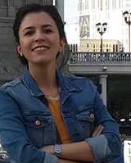
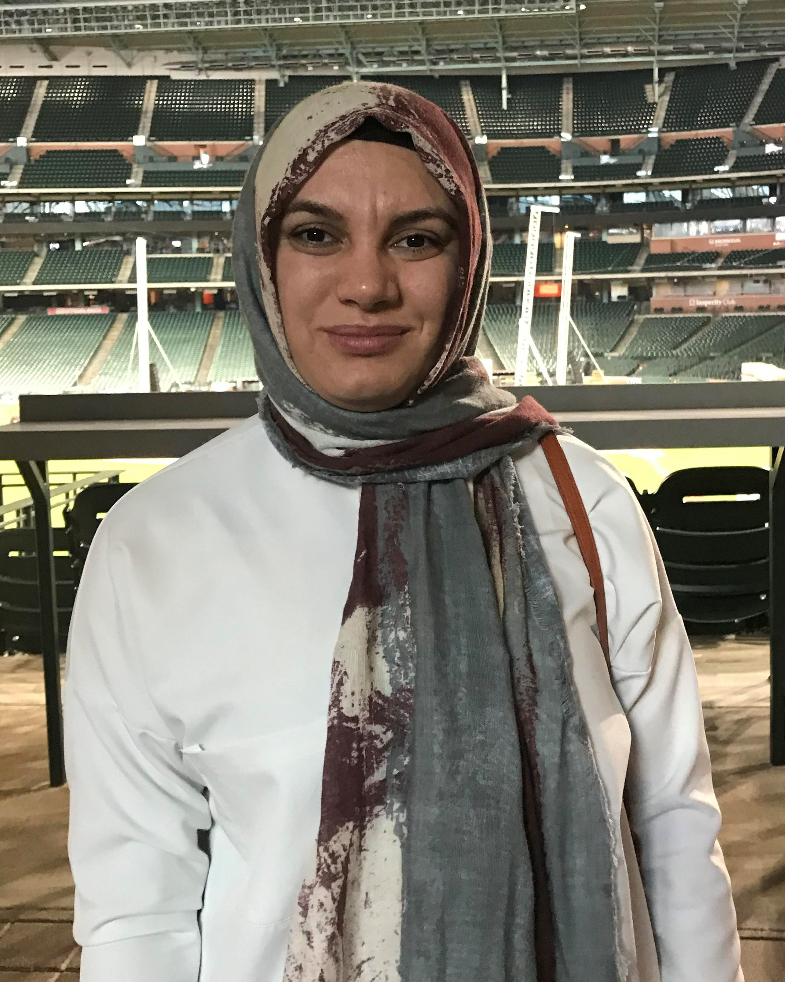
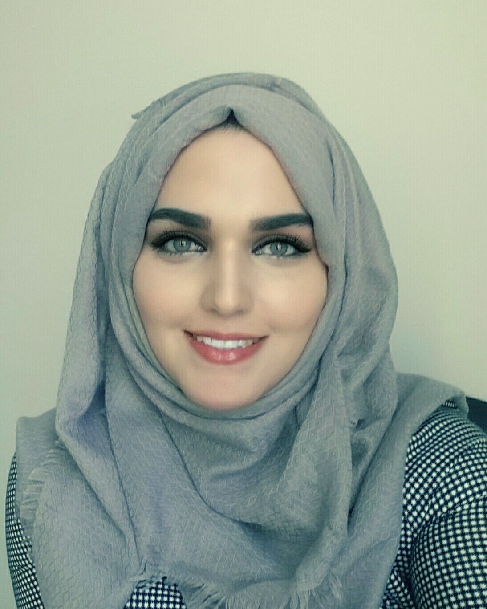
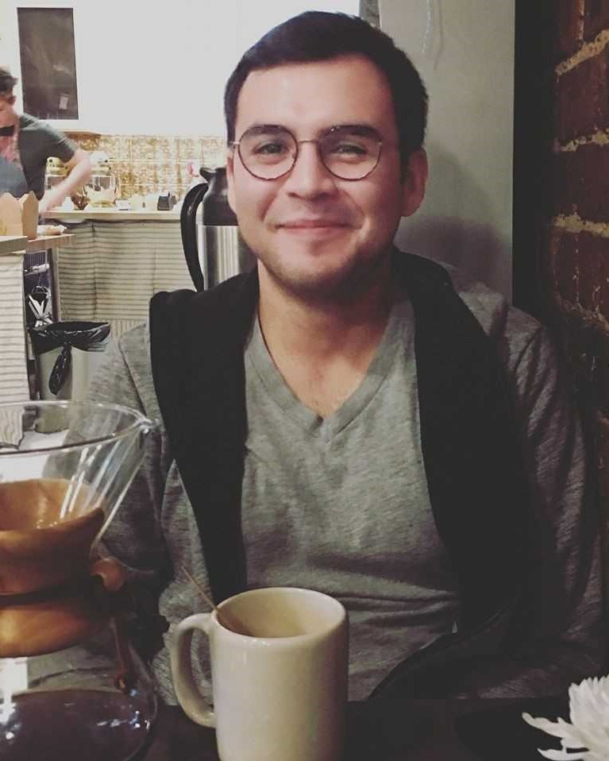
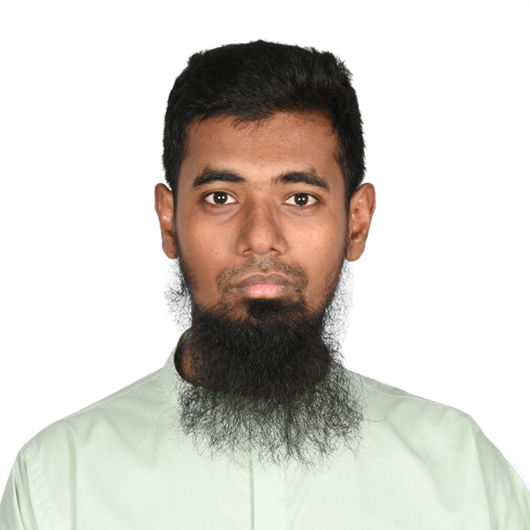

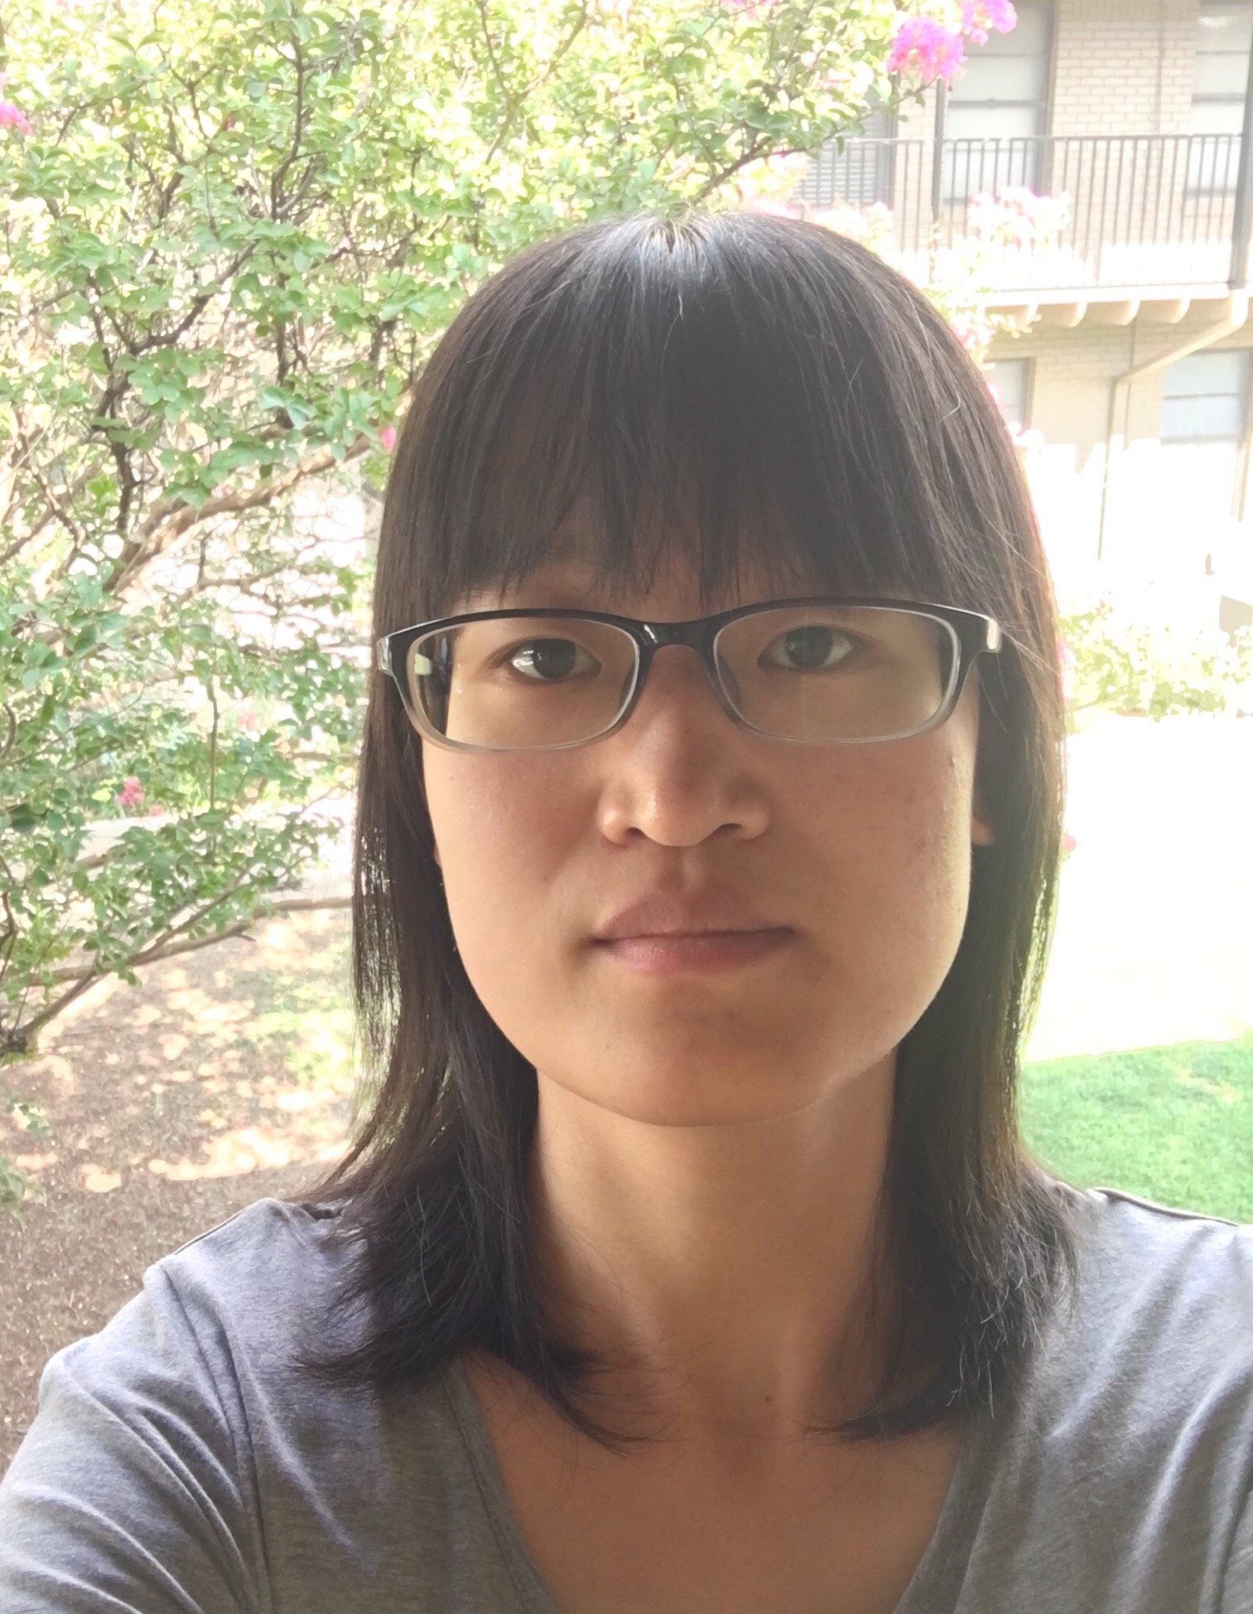
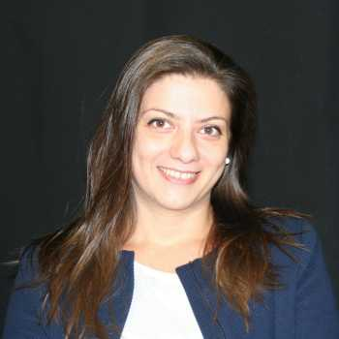
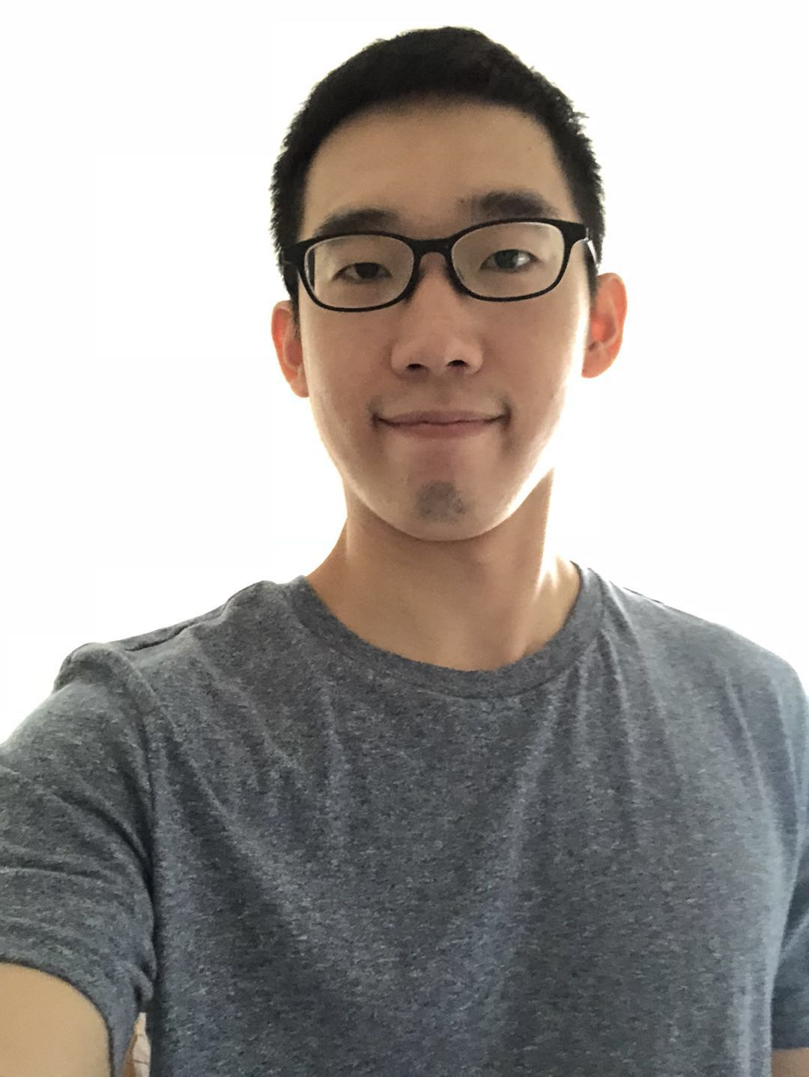
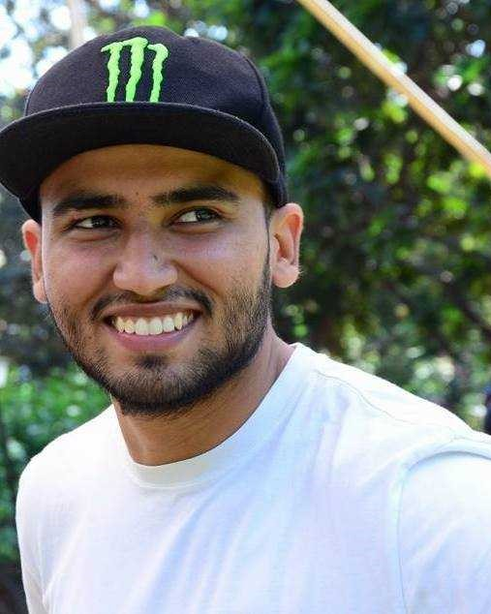
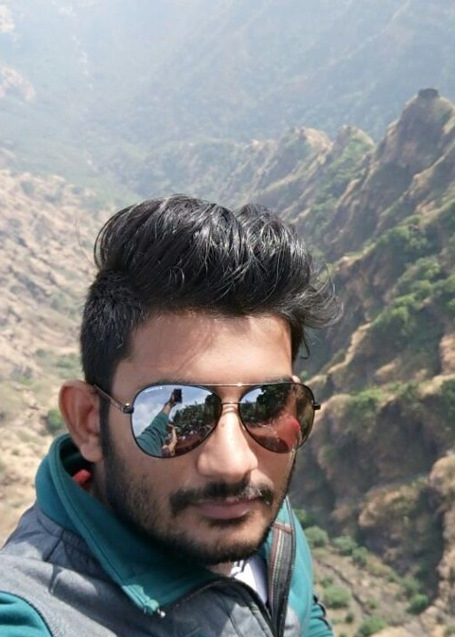
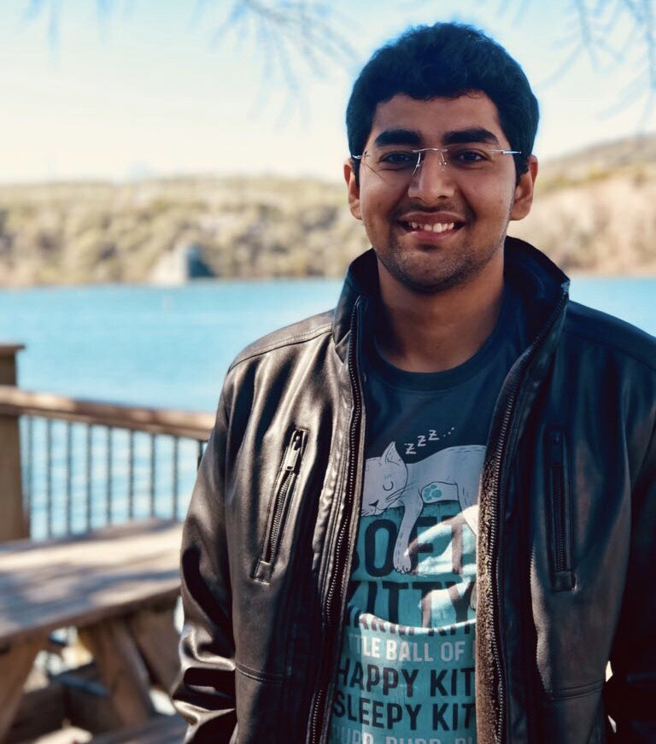
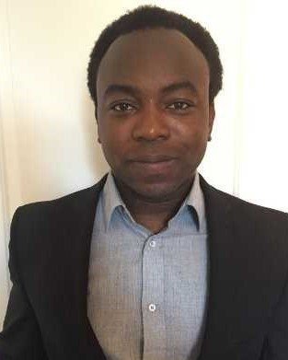
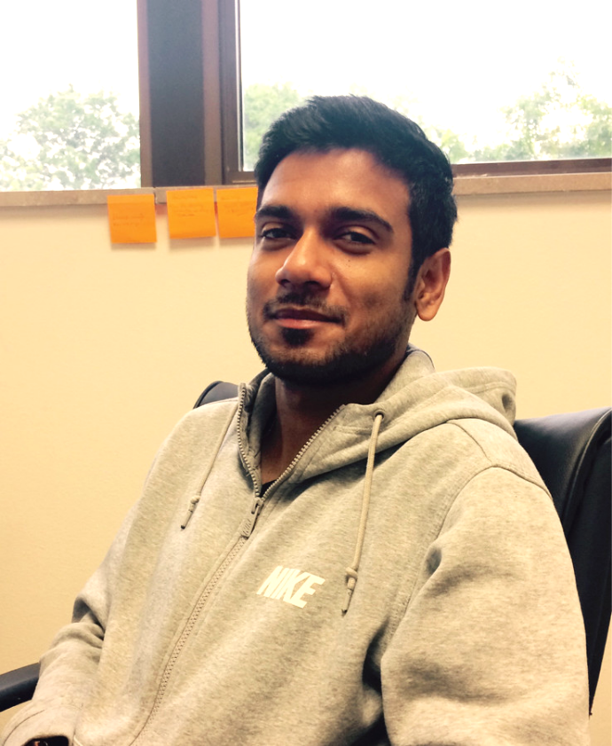
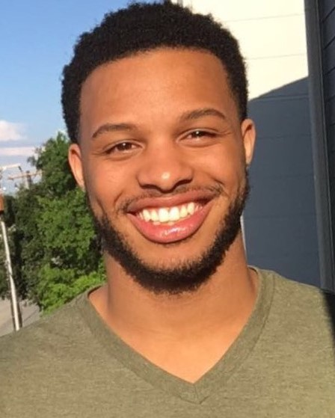
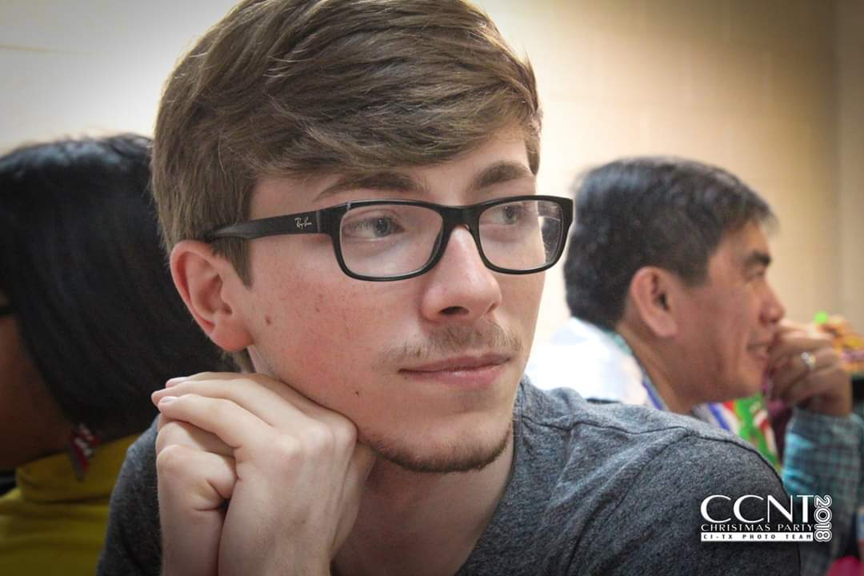
Current IDIR Students
Ph.D. students
Farahnaz
Akrami
Fatma
Arslan
Israa
Jaradat
Damian
Jimenez
Shadekur
Rahman
Samiul
Saeef
Xiao
Shi
Theodora
Toutountzi
Zeyu
Zhang
M.S. students
B.S. students
Priyank
Arora
Sumeet
Lubal
Sarthak
Majithia
Daniel
Obembe
Sarbajit
Roy
Kyrell
Dixon
Jacob
Devasier

Slide 25
Thank you!

